Slide 1

Final Project On Deep Learning in Natural Language Processing for Google’s Virtual Assistant
Instructor: Prof. Chaojiang (CJ) Wu, Ph.D.
Presented By:
Arcot Balraj Tanmaiyee
(811321962)

Slide 2
Introduction
Deep learning has completely changed the way chatbots and virtual assistants are built.
With powerful models like BERT, GPT, and LSTM, these systems can now understand real conversations, remember context, and interact in ways that feel much more natural and personal.
In this project, we explore how deep learning is helping virtual assistants work smarter across industries like healthcare, banking, retail, and education — and how they’re getting better at understanding people just like humans do.

Slide 3
State-of-the-Art Deep Learning Models
Algorithm Used | Purpose | Use Case
BERT (Bidirectional Encoder Representations from Transformers) | Contextual Understanding – Intent recognition, slot filling. | Google Assistant
GPT (Generative Pretrained Transformer) | Language Generation – Open domain chat, dialogue generation | ChatGPT
BART (Bidirectional and Auto-Regressive Transformers) | Natural Language Processing – Text generation, translation | Facebook Messenger bots
LSTM/GRU (Long Short-Term Memory/ Gated Recurrent Unit) | Sequence Modelling – Response prediction, context retention | FAQ bots
Bi-LSTM-CRF ( Bidirectional LSTM with Conditional Random Fields) | Input/Output Transformation – Generating chat response | Early versions for Google Translators, email responders.
RL | Dialogue Optimization – For ideal conversational conditions | Google Assistant
CLIP (Contrastive Language–Image Pretraining) | Multimodal Learning – Visual virtual bots | Voice-controlled apps.
mBERT/XLM-R (Multilingual BERT / Cross-lingual Model) | Cross-lingual text understanding – Multilingual bots | Amazon Alexa
Seq2Seq (Sequence to Sequence) | Sequence Tagging – Named entity recognition | Medical text processing, form-based chatbots.
Transformer Model
Recurrent Neural Network Model
Reinforcement Learning
Multimodal Model
Cross-lingual Model
Sequence to Sequence Model

Slide 4
Literature Review
BERT one of the most influential models in NLU research (Jacob Devlin, 2018). It is very good at activities like entity recognition and intent detection because of its architecture.
As an autoregressive model trained on 175 billion parameters, GPT-3 can generate astonishingly fluent and logical prose, making it well-suited for open-domain chatbots (Tom B. Brown, 2020).
(Colin Raffel, 2020) presented T5 (Text-to-Text Transfer Transformer), which consolidated NLP tasks under a text-to-text framework.
mBERT (Multilingual BERT) and XLM-R (Alexis Conneau, 2020) allow chatbots to function in many languages by leveraging common representations.

Slide 5
Challenges & Limitations
Challenge | Key References
Content Retention - Hard to maintain long-term context in multi-turn conversations. | (Jiwei Li, Deep Reinforcement Learning for Dialogue Generation, 2019).
Processing Costs - Large models need heavy computation, limiting real-time use. | (Tom B. Brown, 2020); (Colin Raffel, 2020)
Data Requirements - Requires large datasets, limiting low-resource language support. | (Alexis Conneau, 2020)
Fairness & Bias - Models often reflect and amplify training data biases. | (Emily M. Bender, 2021)
Explainability - Deep models are hard to interpret, especially in sensitive tasks. | (Marco Tulio Ribeiro, 2019)
Multi-lingual Performance - Struggles with low-resource languages and cultural nuance. | (Shijie Wu, 2020)
Real-Time Response - High latency slows down real-time applications. | (Victor Sanh, 2019

Slide 6
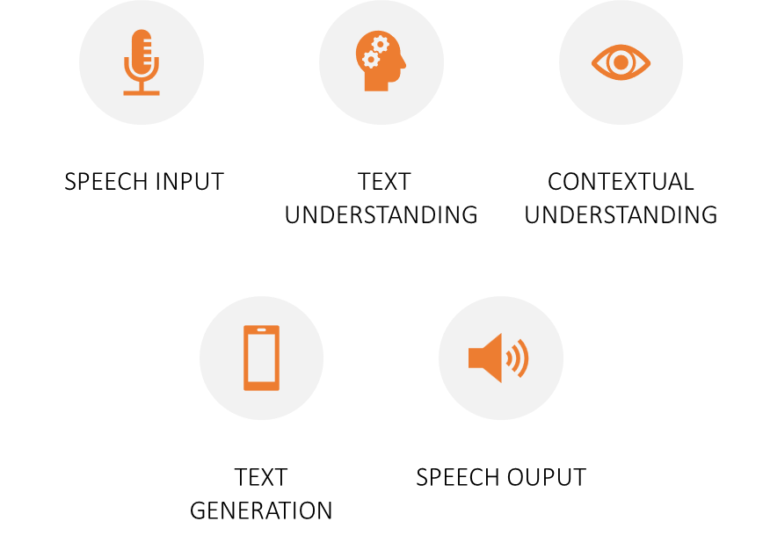
Chatbots and Virtual Assistants for Google Assistant
Google Assistant uses a variety of deep learning algorithms to process and understand natural language, generate responses, and provide personalized assistance. While Google does not publicly disclose every specific algorithm or model used in Google Assistant, we can infer its core technologies based on the general principles of deep learning, Google’s AI research, and the architecture used in many of their services.
This process also includes personalization, Multimodal Input, Translation.
Logical Flow | Algorithms Used
Speech Input | ASR, RNN, LSTM
Text Understanding | BERT, LSTM, NER
Contextual Understanding | Memory Networks/ Transformer attention
Text Generation | GPT
Speech Output | Wavenet, Tacotron 2

Slide 7
Industry Applications
Sector | Real-time Application | Algorithm/Model Used
Healthcare | Babylon Health Woebot | BERT/GPT-3 LSTM/BERT
Banking & Finance | Bank of America’s Erica JP Morgan’s COiN | LSTM/RL NER-BERT
E-Commerce & Retail | Sephora’s Virtual Assistant H&M’s Chatbot | GANs BERT/GPT-3
Telecommunication | Vodafone’s TOBi T-Mobile’s Tinka | BERT/RL BERT/Seq2Seq
Education | Duolingo’s Chatbot Carnegie Learning MATHia | LSTM/RL Deep Neural Networks
Travel | KLM’s Bluebot Skyscanner’s Chatbot | BERT/GPT-3/LSTM BERT/XLNet
Customer Service | Zendesk’s Answer Bot Slack’s Virtual Assistant | BERT/spaCy RNNs/GPT-3

Slide 8
Limitations
High Resource Consumption: Requires significant computational power, which can slow down older devices.
Latency: Slight delays in response time, especially with complex queries or poor internet connection.
Contextual Understanding: Struggles with maintaining context in multi-turn conversations.
Multilingual & Accented Speech: Challenges in recognizing regional accents and less common languages.
Limited Customization: Restricted options for personalizing voice or responses.

Slide 9
Future Scope
Emotionally Intelligent: Recognize and respond to user emotions in real time.
Multimodal Interaction: Combine voice, text, vision, and gestures for natural communication.
Hyper-Personalization: Adapt to user tone, context, and behavior for tailored responses.
Offline & Low-Bandwidth Support: Lightweight models for reliable use in poor connectivity.
Self-Learning: Continuously improve through real-time user interactions without retraining.

Slide 10
Conclusion
NLP has made chatbots and virtual assistants smarter, helping them understand and respond to us more naturally. They've grown from basic systems to more context-aware assistants thanks to technologies like BERT and GPT. In the future, virtual assistants will get even better at understanding emotions, becoming more flexible and accessible to everyone. With more transparent and efficient systems, they’ll be an even bigger part of our daily lives, making tech feel more human.

Slide 11
Thank You!

